Slide 1

Recommendify
Recommendation System for Spotify Playlists
Arda Barış Örtlek 21903472
Ayşın Tümay 21902058
Bahadır Aydoğan 21903064
Barış Tiftik 21702427

Slide 2
Contents
01. Introduction
02. Preprocessing
What we have done
Spotify API
Preprocessing
Feature Reduction
03. K-Means
04. DBScan
05. Conclusion
k-Means Model
No Feature Extraction
PCA
Autoencoder
DBSCAN Model
No Feature Extraction
PCA
Autoencoder
Comparison of the Models
The Chosen Model
A Successful Recommendation

Slide 3
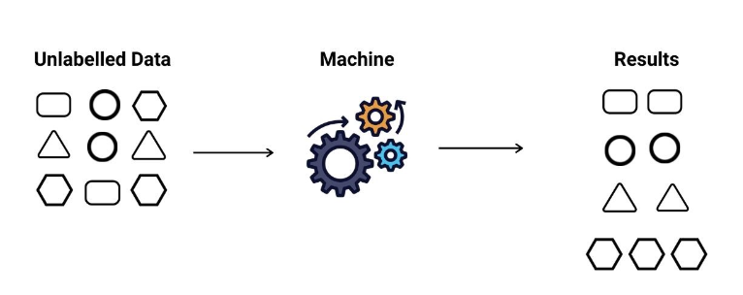
Unsupervised Learning
Fig.2: Explanation of unsupervised learning [2].

Slide 4

Introduction
The playlists containing a set of songs with features compatible with each other.
The track features in the playlist were accessed by using Spotify Web API and vectorized.
Then, the average of these features will create a single vector of the desired track in the similar sense with the playlist.
The trained model will give recommendations.
Fig.1: Spotify playlist [1]

Slide 5
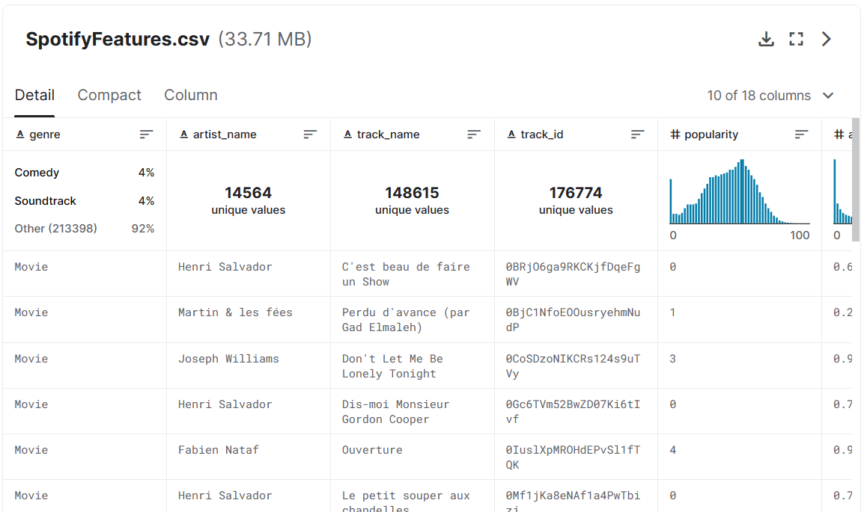
Training Set
Fig.3: Spotify Web API [3].

Slide 6
Features
speechiness
tempo
valance
energy
instrumentalness
duration
liveness
acousticness
loudness
danceability
popularity

Slide 7
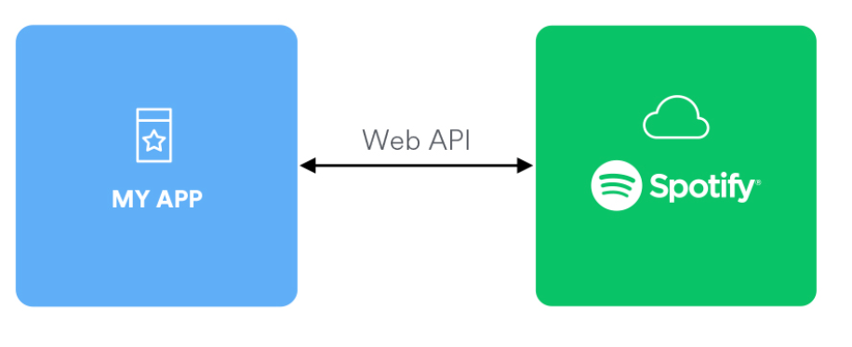
Spotify API
Fig.3: Spotify Web API [3].

Slide 8
Preprocessing
Training Data
Test Data
Spotipy
One-Hot Encoding
Spotify Clients Credentials
Meaningful Features
Keys: {A, B, C, D, E, F, G}
Modes: {Major, Minor}
Scaling
Ready
Absolute Maximum .Scaling
Min-Max Scaling
Ready for the model

Slide 9
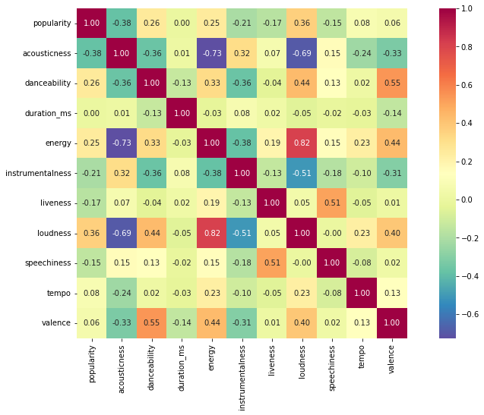
Correlation Heatmap of the Features
Fig.4: Heatmap for feature correlation.

Slide 10
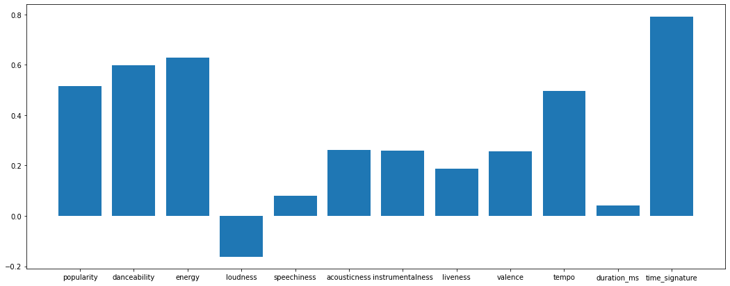
Test Playlist Characteristics
Fig.5: Musical properties of test playlist 1.

Slide 11

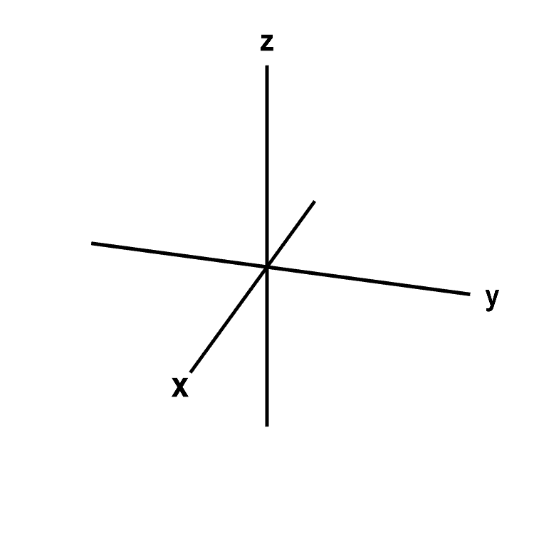
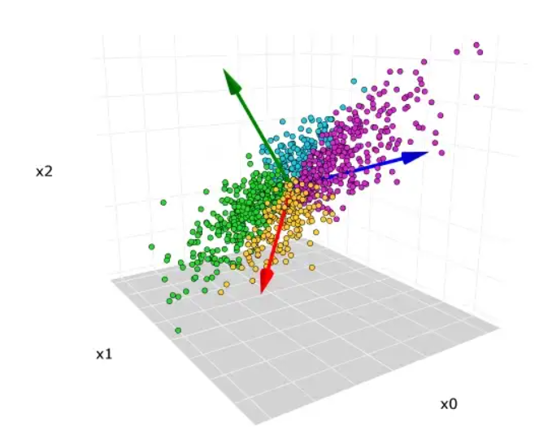
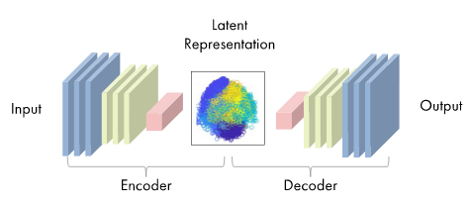
Three Different Inputs
No Feature Reduction
Principal Components Analysis (PCA)
Autoencoder
Fig.6: Visualization of no feature Reduction[4].
Fig.7: Visualization of PCA [5].
Fig.8: Visualization of autoencoder [6].

Slide 12

PCA
Dimensionality reduction,
Data compression,
Reduction from 26 features to 15.
Fig.9: Visualization of PCA [5].

Slide 13
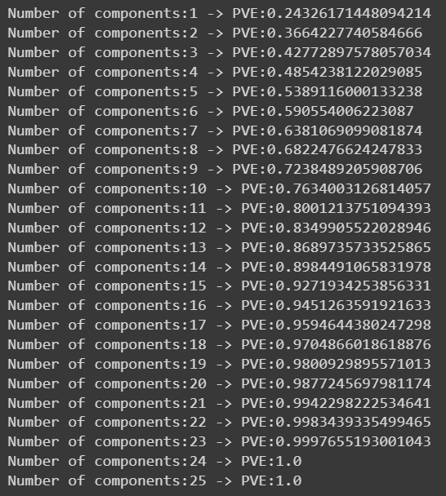
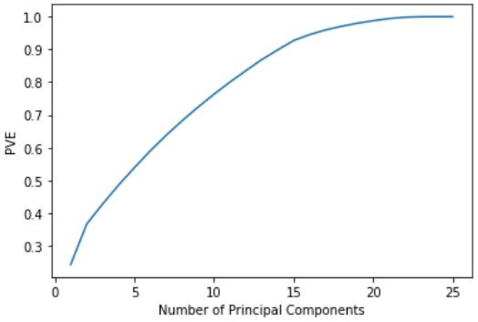
PCA
Fig.10-11: PVE versus number of principal components.

Slide 14
Autoencoder
Dimensionality reduction,
Data compression,
Reduction from 26 features to 15.
Nonlinear transformation
Fig.12: Visualization of autoencoder [6].

Slide 15
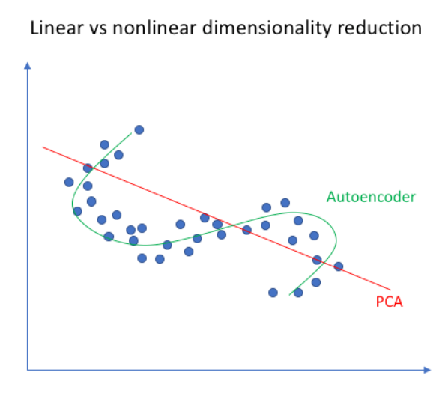
Fig. 13: Autoencoder vs PCA[7]

Slide 16
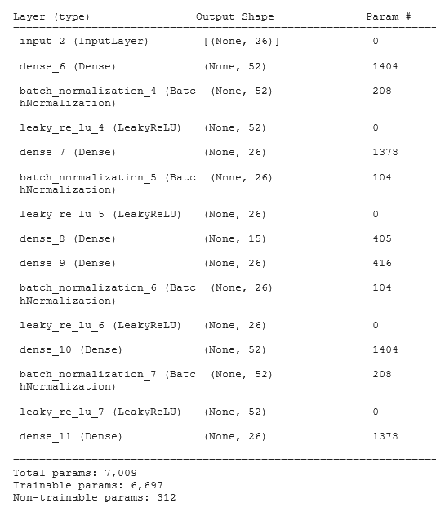
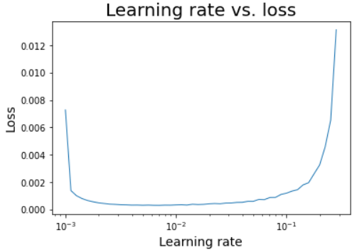
Autoencoder Implementation
Fig. 15:Learning rate vs loss
0.0063 is the selected learning rate.
Fig. 14: Model summary

Slide 17
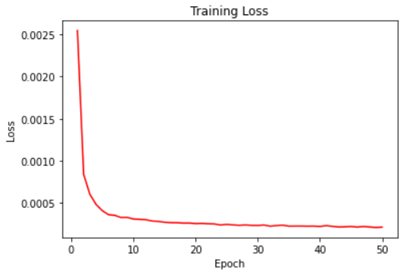
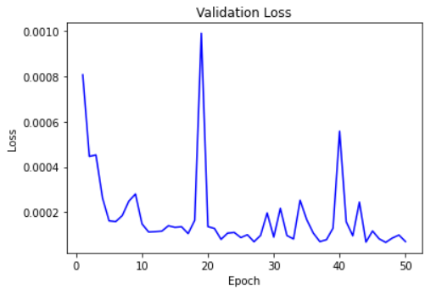
Autoencoder Implementation
Fig. 16: Training loss over 50 epochs
Fig.17 :Validation loss over 50 epochs
Final training loss: 2.1262e-04
Final validation loss: 6.9806e-05

Slide 18
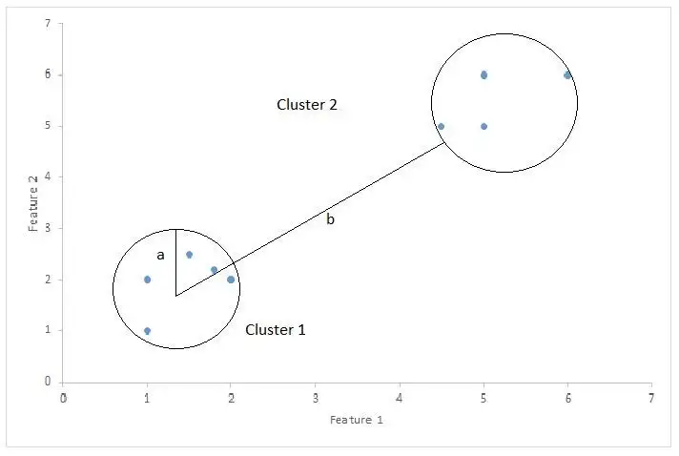
Evaluation Metric for Clustering
Silhouette Score
mean intra-cluster distance: a
mean nearest-cluster distance: b
1: Successfully distinguished clusters.
0: The distance between the clusters is insignificant.
-1: Clusters are assigned opposite.
Fig. 18 : Silhouette Score visualization [8]

Slide 19
k-Means
Unsupervised learning.
The goal is to cluster data points into k clusters with the minimized sum of distances between data points and their cluster centroids.

Slide 20
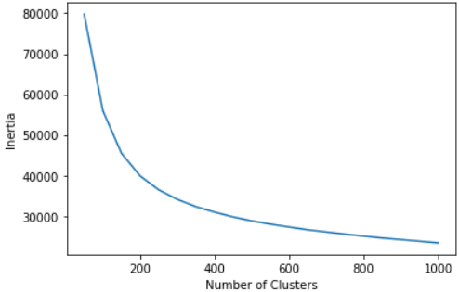
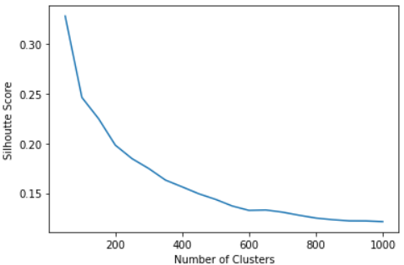
k-Means - No Feature Reduction
Fig.19 : Inertia vs number of clusters
Fig. 20:Silhouette Score vs number of clusters
Elbow for the inertia graph is 250

Slide 21
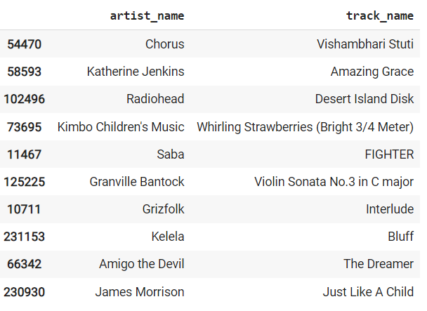
Song Recommendations with k-Means-No Feature Reduction
Fig.21 : Recommended songs for test_1

Slide 22
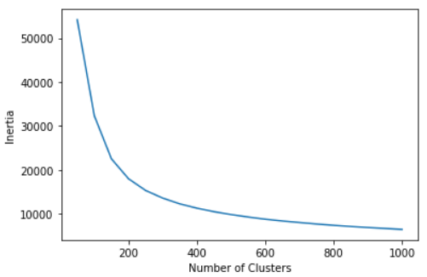
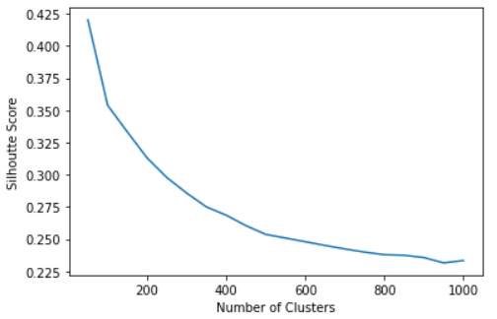
k-Means - PCA
Fig. 22: Inertia vs number of clusters
Fig. 23:Silhouette Score vs number of clusters
Elbow for the inertia graph is 250

Slide 23
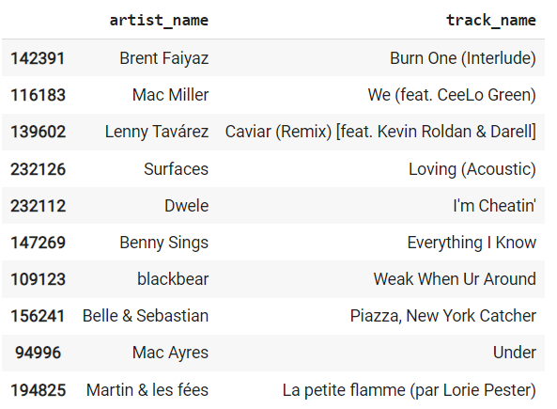
Song Recommendations with k-Means-PCA
Fig.24 : Recommended songs for test_1

Slide 24
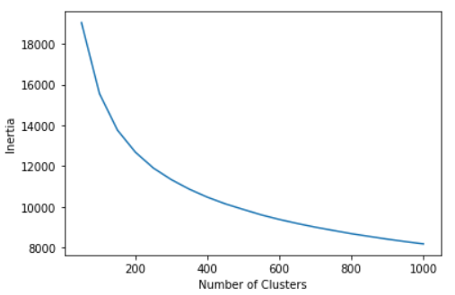
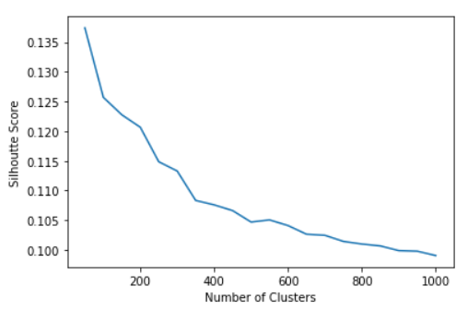
k-Means - Autoencoder
Fig. 25: Inertia vs number of clusters
Fig.26 :Silhouette Score vs number of clusters
Elbow for the inertia graph is 250

Slide 25
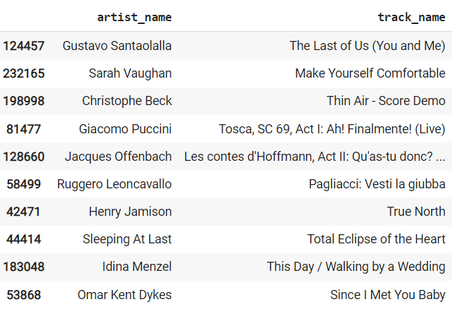
Song Recommendations with k-Means-Autoencoder
Fig.27 : Recommended songs for test_1

Slide 26
DBSCAN Model
What is DBSCAN?
Tuned Hyperparameters
A density based clustering algorithm with noise.
Efficient for data with similar densities.
Finds high density samples and generates clusters according to these samples.
Epsilon: the maximum euclidean distance for 2 samples to be considered as neighbors.
A search method for optimal eps is computed.
Min_samples : the minimum number of samples in the neighbourhood to be considered as core point.
Optimal min_samples is #features*2 [9].

Slide 27
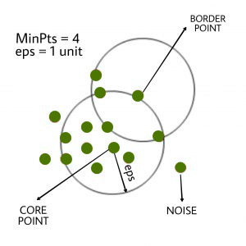
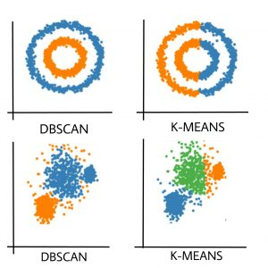
DBSCAN Model
Model Visualization
Fig.28 : Comparison between k-Means and DBSCAN.
Fig.29 : DBScan working principle [10].

Slide 28
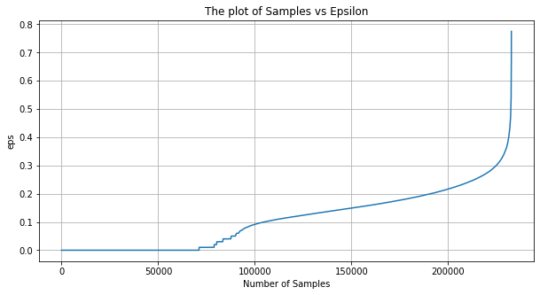
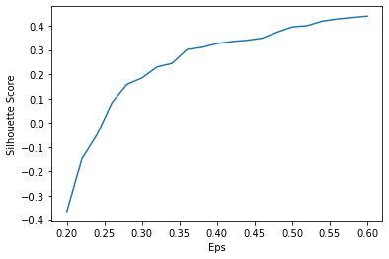
DBSCAN Model with no Feature Reduction
Hyperparameter Tuning
Epsilon: 0.8,
min_samples: 26*2=52
Fig.30: k-NN results to detect the knee for “epsilon”.
Fig.31: The plot of Silhouette score versus “epsilon” .

Slide 29
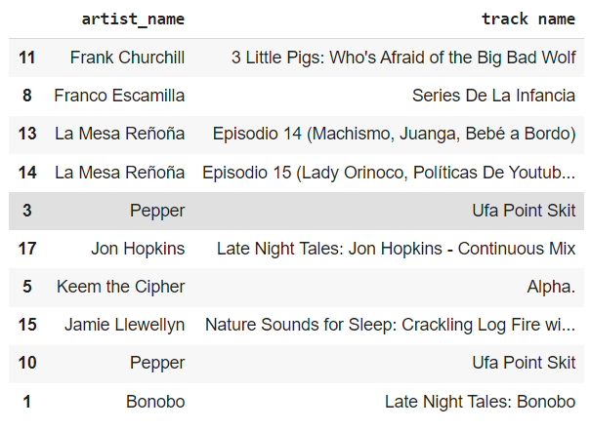
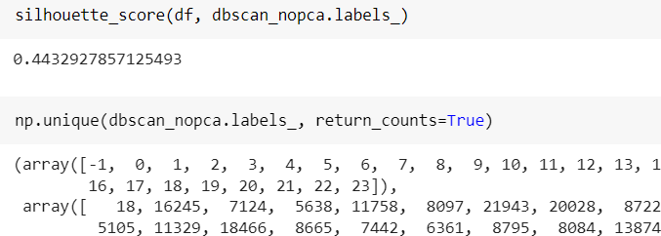
Song Recommendations
Fig.32 : The silhouette score of the final model, and distribution of clusters.
Fig.33 : Recommended songs for test_1

Slide 30
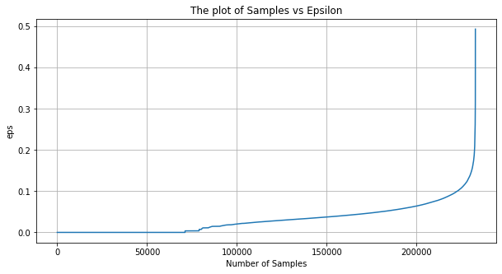
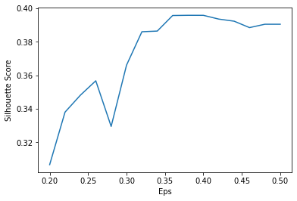
DBSCAN Model with PCA
Hyperparameter Tuning
Epsilon: 0.8,
min_samples: 15*2=30
Fig.34: k-NN results to detect the knee for “epsilon”.
Fig.35: The plot of Silhouette score versus “epsilon”

Slide 31
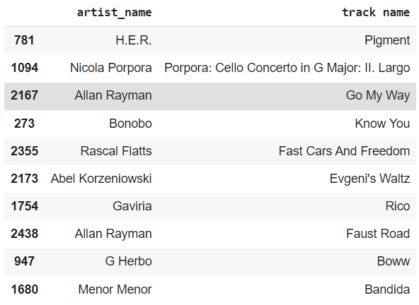
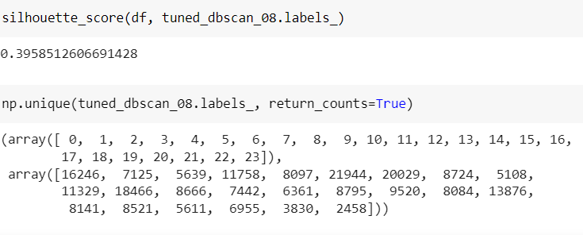
Song Recommendations
Fig.36 : The silhouette score of the final model, and distribution of clusters.
Fig.37 : Recommended songs for test_1

Slide 32
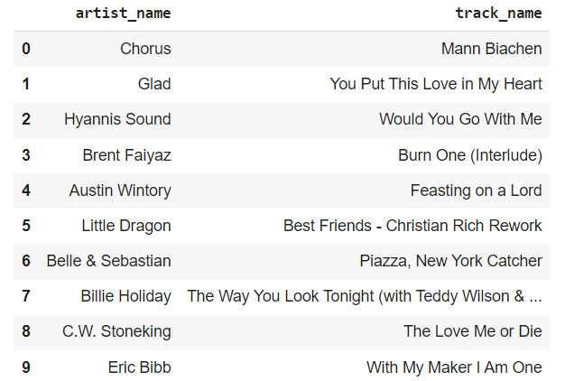
Song Recommendations
Fig.38 : Recommended songs for test_1 with cosine similarity

Slide 33
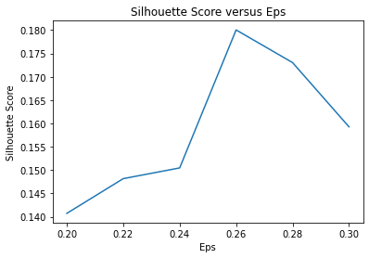
DBSCAN Model with Autoencoder
Hyperparameter Tuning
Epsilon: 0.26,
min_samples: 15*2=30
Fig.39: The plot of Silhouette score versus “epsilon”

Slide 34
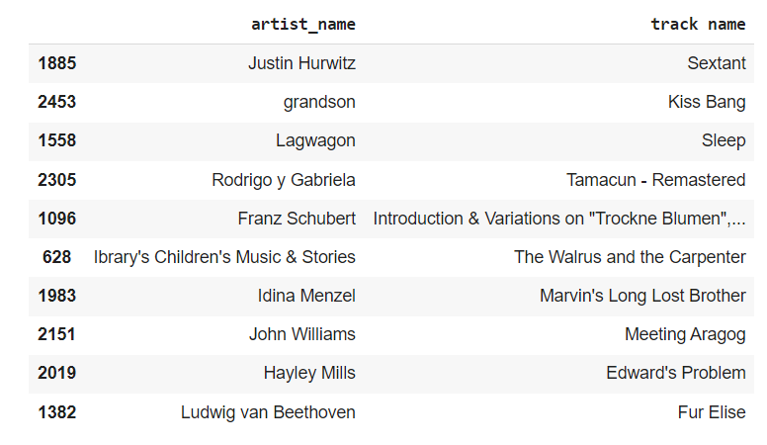
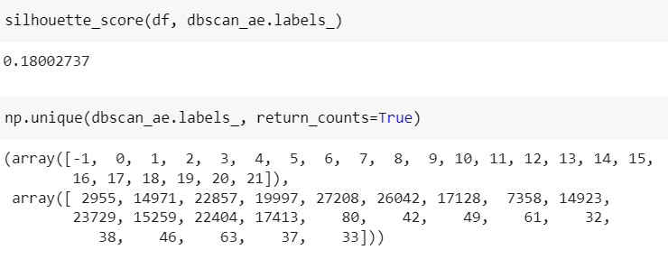
Song Recommendations
Fig.40 : The silhouette score of the final model, and distribution of clusters.
Fig.41 : Recommended songs for test_1

Slide 35
Conclusion
Table. 1: Comparison of Silhouette scores of experiments.
 | No Feature Reduction | PCA | Autoencoder
k-Means | 0.184 | 0.297 | 0.114
DBSCAN | 0.444 | 0.396 | 0.180

Slide 36
Conclusion
The Chosen Model: k-Means Model with PCA
Why k-Means?
The runtime is shorter than DBSCAN model.
The cluster number is tunable.
More precise recommendations.
Why PCA?
Our data is more suitable for linearization, works poorer with nonlinear activation functions.
One-hot encoding columns cause sparsity without feature reduction.

Slide 37
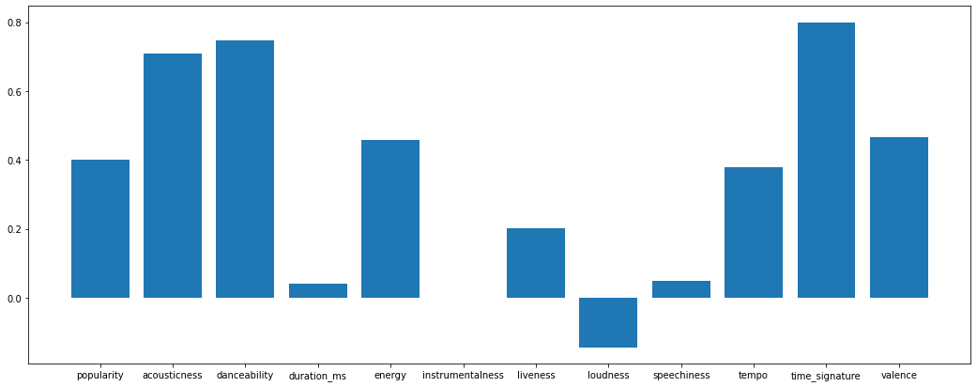
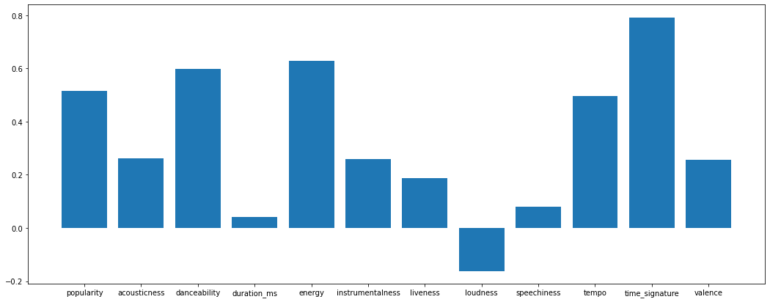
Conclusion
Fig.42: A successful recommendation: Soul-Dwele

Slide 38
References
[1]“Welcome to the jungle,” Spotify. [Online]. Available: https://open.spotify.com/playlist/7d9jJN26uZrs1GTM3aHf5u?si=b125ba8954464864. [Accessed: 20-Dec-2022].
[2]R. Raj, “Supervised, unsupervised and semi-supervised learning with real-life USECASE,” enjoyalgorithms. [Online]. Available: https://www.enjoyalgorithms.com/blogs/supervised-unsupervised-and-semisupervised-learning. [Accessed: 20-Dec-2022].
[3]“Web api,” Spotify for Developers. [Online]. Available: https://developer.spotify.com/documentation/web-api/. [Accessed: 20-Dec-2022].
[4]“Math insight,” Cartesian coordinates - Math Insight. [Online]. Available: https://mathinsight.org/cartesian_coordinates. [Accessed: 20-Dec-2022].
[5]C. Cheng, “Principal Component Analysis (PCA) explained visually with Zero math,” Medium, 22-Mar-2022. [Online]. Available: https://towardsdatascience.com/principal-component-analysis-pca-explained-visually-with-zero-math-1cbf392b9e7d. [Accessed: 20-Dec-2022].
[6]“Autoencoders,” MATLAB & Simulink. [Online]. Available: https://www.mathworks.com/discovery/autoencoder.html. [Accessed: 20-Dec-2022].
[7]J. Jordan, “Introduction to autoencoders.,” Jeremy Jordan, 19-Mar-2018. [Online]. Available: https://www.jeremyjordan.me/autoencoders/. [Accessed: 20-Dec-2022].
[ 8] A. Bhardwaj, “Silhouette coefficient : Validating clustering techniques,” Medium, 27-May-2020. [Online]. Available: https://towardsdatascience.com/silhouette-coefficient-validating-clustering-techniques-e976bb81d10c. [Accessed: 20-Dec-2022].
[ 9] T. Mullin, “DBSCAN parameter estimation using Python,” Medium, 15-Jul-2020. [Online]. Available: https://medium.com/@tarammullin/dbscan-parameter-estimation-ff8330e3a3bd. [Accessed: 03-Dec-2022].
[10 ] “DBSCAN clustering in ML: Density based clustering,” GeeksforGeeks, 24-Aug-2022. [Online]. Available: https://www.geeksforgeeks.org/dbscan-clustering-in-ml-density-based-clustering/. [Accessed: 20-Dec-2022].

